Slide 1
IT752 WSC - Mini-project Progress Evaluation [Jan-May 2023]
A Multilayered Informative Random Walk for Attributed Social Network Embedding
Presented By:
Man Mohan Nayak (222IT019)
Nikhil Verma (222IT026)

Slide 2
Introduction
Social Network Embedding is a technique used in machine learning to represent the nodes or entities of a social network as low-dimensional vectors or embedding. These embedding capture the structural and relational information of the social network and can be used for a variety of downstream tasks such as node classification, link prediction, and community detection.
The basic idea behind social network embedding is to learn a mapping from the high-dimensional space of the social network to a low-dimensional space where the nodes can be represented as vectors. This mapping is learned through various optimization techniques such as neural networks, matrix factorization, or random walks. The resulting embedding preserve the relationships between nodes in the original network, such as similarity, proximity, and connectivity.
Social network embedding has many applications in various fields such as social network analysis, recommendation systems, and fraud detection. It has been widely used in industry and academia, and has led to significant improvements in the performance of many social network-related tasks.

Slide 3
Literature Review
Authors/Year | Methodology | Advantages | Limitations
Jiaxuan You, Rex Ying, and Jure Leskovec/ 2019 | Proposes a positional aware GNN architecture to encode the position of each node in a graph. | Encodes the position of each node in the graph representation. | May not generalize well for graph with different topologies or node distributions.
Brian Gallagher and Tina Eliassi-Rad/ 2010 | Updates the labels of the nodes based on the labels of their neighbour and the label independent feature vector. | Leverages label independent features for classification. | Computationally expensive when applied to large-scale networks.
Daixin Wang, Peng Cui, and Wenwu Zhu /2016 | Deep neural network takes as input adjancency matrix and outputs a low dimensional vector. | Low dimensional representation of complex network that can capture both local and global structural properties. | Consider only the link structure of the network.

Slide 4
Outcome of literature review.
Methods to encode the position of the nodes in the graph representation.
a complex network can be represented as low dimensional vector and still captures local and global properties.

Slide 5
Problem Statement & Objective
Given G, the task is to find some low dimensional vector representation of the nodes of G which is consistent with both the structure of the network and the content of the nodes. More formally, for the given network G, the network embedding is to learn a function f : v_{i} → x_{i} ∈ R_{K}, i.e., it maps every vertex to a K dimensional vector, where K << min(n, d). The representations should preserve the underlying semantics of the network. Hence the nodes which are close to each other in terms of their positional distance or similarity in content should have similar representation.
Objectives:
Generate high-quality node embedding
Preserve the local and global network structure
Handle large-scale networks
Incorporate structural and attribute information

Slide 6
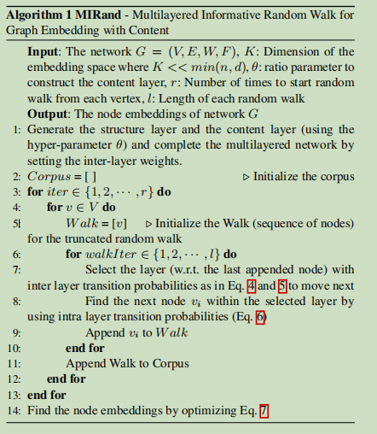
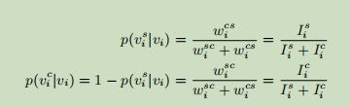
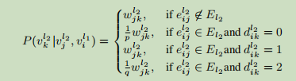

Existing Methodology
Algorithm
Formula

Slide 7


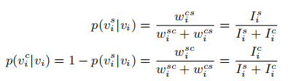
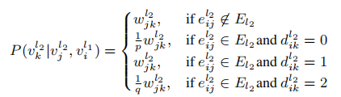
cont..
1st step:
construct structural layer (same as original network without content information ) and content layer ( calculating the cosine similarity among nodes ) eliminate edges with -ve similarity values .
2 nd step:
calculate the imformativeness of each node using below formula
3rd step: at each vertex we have to choose structural layer or content layer based on inter-layer transition probability value which is defined by
4th step: after selecting layer we have select next node using max probability

Slide 8
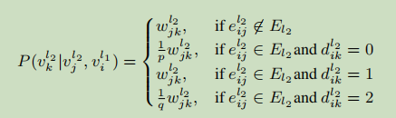
Proposed enhancements/novelty
In our proposed enhancement after switching the layer based on informativeness of layer
While selecting the next node we are considering the informativeness of that node and it’s neighbor nodes instead of taking probabilities ,which is based on the similarities .
Instead of this above equation we are using
Select (V_{k}) = max( I_{i}^{c} / i  i and its neighbors )

Slide 9
Dataset
The Cora dataset consists of 2708 scientific publications classified into one of seven classes. The citation network consists of 5429 links. Each publication in the dataset is described by a 0/1-valued word vector indicating the absence/presence of the corresponding word from the dictionary. The dictionary consists of 1433 unique words.

Slide 10
Work done
Literature survey of related works(mentioned in the references).
Create a graph using structural and content attributes.
Generate walk by switching to content or structure layer based on the transition probability.
using Word2Vec for generating the embedding of each node.
Result:
Word2Vec object consisting of embedding of nodes in the network.

Slide 11
Individual contribution
Nikhil Verma (222IT026) | Man Mohan Nayak (222IT019)
Literature Survey | Literature Survey
Base paper implementation | Proposed modification

Slide 12
References
[1] William L Hamilton, Rex Ying, and Jure Leskovec, ‘Representa
tion learning on graphs: Methods and applications’, arXiv preprint
arXiv:1709.05584, (2017).
[2] Daixin Wang, Peng Cui, and Wenwu Zhu, ‘Structural deep network
embedding’, in Proceedings of the 22nd ACM SIGKDD international
conference on Knowledge discovery and data mining, pp. 1225–1234.
ACM, (2016).
[3] Brian Gallagher and Tina Eliassi-Rad, ‘Leveraging label-independent
features for classification in sparsely labeled networks: An empirical
study’, in Advances in Social Network Mining and Analysis, 1–19,
Springer, (2010).
Dataset: https://linqs.soe.ucsc.edu/data

